Slide 1
Atmosphere
6th Grade Science

Slide 2
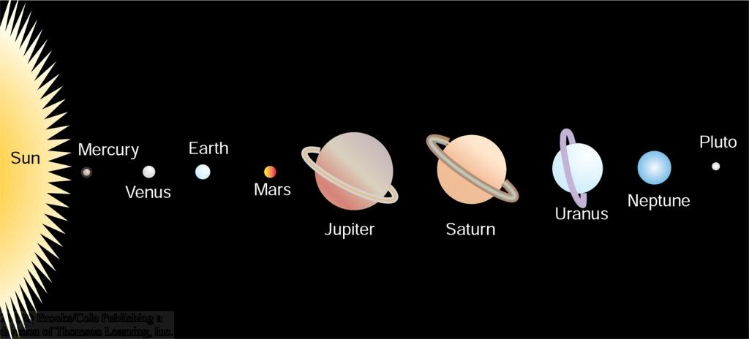
Solar Energy as Radiation
Figure 1.1
Nearly 150 million kilometers separate the sun and earth, yet solar radiation drives earth's weather.
Notes:
At it’s Surface, the earth maintains an average temp of 59F
With a wide range of temperature readings
-121F during the Antarctica night
122F in deserts

Slide 3
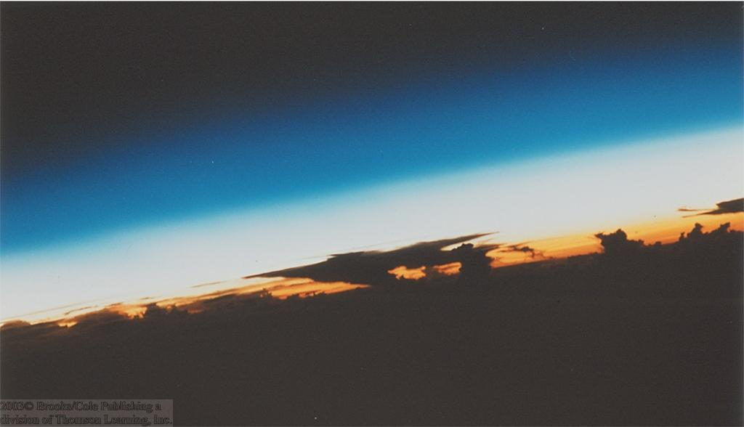
Earth's Atmosphere
Thin Gaseous envelope
Figure 1.2
The atmosphere is a thin layer of air that protects the Earth’s surface from extreme temperatures and harmful sun rays

Slide 4
Composition of Atmosphere (Mixture of gases, solids, and liquids)
Early atmosphere was much different than today
Volcanoes produced nitrogen and carbon dioxide, but little oxygen
More than 2 billion years ago, early organisms began producing oxygen
Eventually, oxygen formed an ozone layer that protected Earth from harmful rays
Green plants and diverse life forms developed

Slide 5
Atmospheric Gases (Mixture of gases, solids, and liquids)
Nitrogen - 78%
Oxygen - 21%
Water Vapor – 0 to 4%
Used for clouds and precipitation
Carbon Dioxide - .037%
Keeps Earth warm and is used by plants to make food
Argon - .93%
Traces of neon, helium, methane, krypton, xenon, hydrogen, and ozone

Slide 6
Atmospheric Gases (Mixture of gases, solids, and liquids)
Atmosphere is changing with the introduction of pollutants; increasing human energy use is increasing the amount of carbon dioxide
Pollutants mix with oxygen and other chemicals to form smog
Aerosols include solids such as dust, salt, and pollen
Liquids include water droplets and droplets from volcanoes

Slide 7
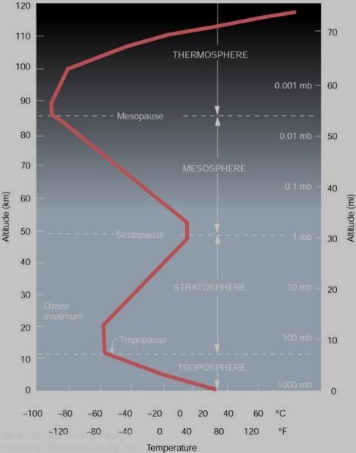
Five Layers of the Atmosphere

Slide 8
Lower Layers of Atmosphere
Troposphere: lowest layer – extends up to 10km; contains 99% of the water vapor and 75% of the atmospheric gases
The troposphere is the first layer above the surface and contains most clouds and half of the Earth's atmosphere.
Weather occurs in this layer.
Most of the layer’s heat is from Earth
Temperature cools about 6.5 degrees Celsius per kilometer of altitude.

Slide 9
Lower Layers of Atmosphere
Stratosphere – directly above troposphere, extending from 10 km to about 50 km above Earth’s surface
Portion of the upper layer contains high levels of a gas called ozone
Many jet aircrafts fly in the stratosphere because it is very stable. Also, the ozone layer absorbs harmful rays from the Sun.

Slide 10
Upper Layers of Atmosphere
Mesosphere – extends from the top of the stratosphere to about 85 km above Earth
Coldest layer with little ozone
Meteors or rock fragments burn up in the mesosphere.
Ionosphere here – layer of charged particles

Slide 11
Upper Layers of Atmosphere
Thermosphere – thickest atmospheric layer found between 85 km and 500 km above Earth’s surface
The thermosphere is a layer with auroras, known for its high temperatures.
Warms as it filters out X-rays and gamma rays from the Sun
Ionosphere here, too – help carry radio waves.

Slide 12
Upper Layers of Atmosphere
Exosphere - The atmosphere merges into space in the extremely thin exosphere. This is the upper limit of our atmosphere.
Outer layer where space shuttle orbits.

Slide 13
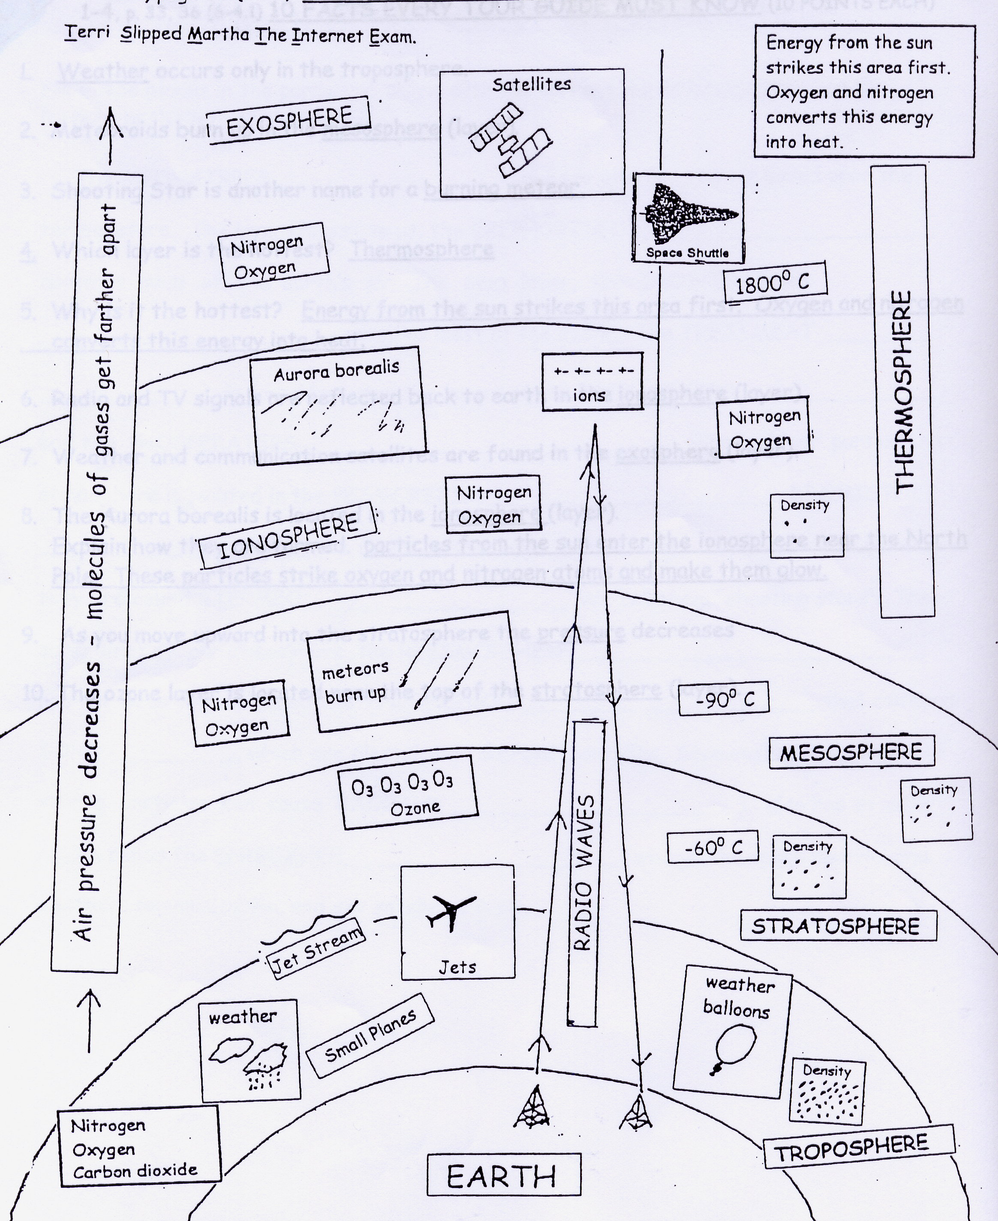
Layers of Atmosphere

Slide 14
Atmospheric Pressure
Molecules closer to the surface are more densely packed (at higher pressure) together than those higher in the atmosphere because of the mass of gases pressing down on them from higher in the atmosphere

