Slide 1
Mr. Schwartz’s Earth Science
2014 - 2015

Slide 2
Mr. Schwartz
Born in Topeka
Grew up in good ol’ AC
ACMS
ACHS
Cowley
SC
Biology

Slide 3
When I’m Not Teaching
Family and Friends
Sports
Soccer
Outdoors

Slide 4
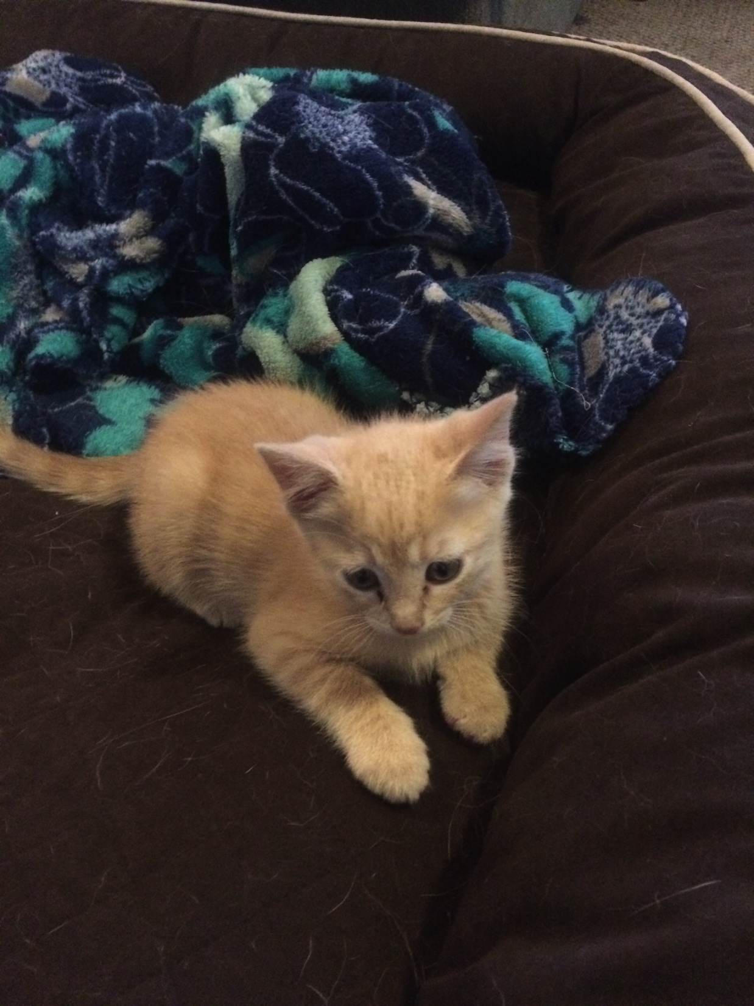
Family

Slide 5
Family

Slide 6
#CamelRideSelfie

Slide 7
Soccer
ACHS
Played
Coach
SC

Slide 9
Rules and Expectations

Slide 10
The Three Rules
#1 Be Respectful
#2 Come ready and willing to learn
#3 Get things done

Slide 11
Lab Rules
No horseplay!
Use equipment correctly, and follow procedures
Sinks
Be safe
Electric plug-ins
Do not put anything in your mouth
Keep things Clean
Doing labs is a privilege

Slide 12
Expectations
Pay Attention
Be Resourceful
No Electronics
Ask appropriate Questions
Stay calm and enjoy learning
If you have to think about it, you probably shouldn’t do it.

Slide 13
Emergencies
ALICE
Fire
Tornados

Slide 14
Call Backs
Who are we!!!
Bullpups!!! Bark twice
White Team!!!
Rocks * 3
Pineapple

Slide 15
Know your classroom

Slide 16
Numbers
Desks
Don’t pick at them
Chrome Books
Fungeon

Slide 17
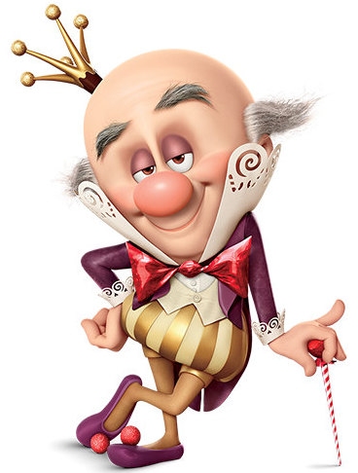
Fungeon
“Fungeon – It’s a fun dungeon”
Wreck it Ralph
Where anything that is distracting anyone from learning goes
Electronics
Balls
Ect

Slide 18
Living Things
5 Plants
Tarantula name Eragog
Fish name Archimedes
Do not touch any of the plants or animals

Slide 19
Work Areas
26 Desks
Reading Area
Tables and chairs
7 Lab Stations
Journal Storage

Slide 20
Out of Bounds
The Teacher’s Lab Station
The Teacher’s Desk Area
Both bookshelves
Back room
Cabinets
Locked
Labeled

Slide 21
Walls
Vocab
Posters
Other Information

Slide 22
Questions???

Slide 23
Explore the Classroom

