Slide 1
Welcome to 6th Grade Earth Science!!
Mr. Phillips
Red Team

Slide 2
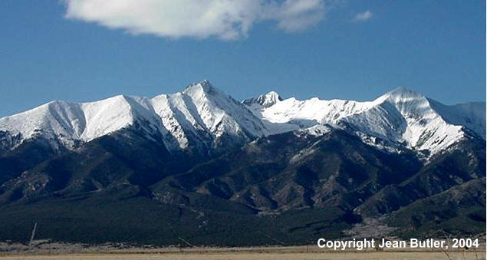
About Me
Born in San Diego, California.
Grew up in southern Colorado.
Mt. Blanca is over 14,000 ft high!!
Great Sand Dunes are the tallest in North America!

Slide 3
More about me
Moved to Winfield in 1996.
Mrs. Phillips teaches 1st grade!
Cowley County Community College (2 Years)
Southwestern College (3 Years)

Slide 4
My interests
I love to spend time outdoors with my family.
Fishing
Boating
Camping
Hiking
Paintball

Slide 5
Class Rules and Expectations

Slide 6
Rules
There are only 3 main rules for this class:
BE……
Respectful
To EVERYONE!!
Responsible
Bring you materials to class!!
Safe
Follow all class and lab rules!!

Slide 7
Lab Safety Expectations
No horseplay!!
Listen to and follow ALL directions.
Use equipment correctly.
Do not put anything in the electric outlets.
Do not put anything in your mouth.
Work TOGETHER with your lab group.
Clean up when you are done.

Slide 8
Labs are a PRIVILEGE!!
If you misbehave during a lab:
You will be asked to complete a different assignment.
You will not get full credit!!

Slide 9
Expectations
I have the right to TEACH, and YOU have the right to LEARN.
Pay attention.
Ask appropriate questions.
No electronics.
Drinking water is allowed.
In a clear container with a lid.
Store under your desk.

Slide 10
In case of a EMERGENCY
ALICE
Fire
Tornado

Slide 11
Call Back
When I say “RED TEAM”
You say “ROCKS”
Let’s try it!!!

Slide 12
Your Classroom

Slide 13
Numbers
Number on your desk:
DON’T PICK AT IT!!!
Matches your Chrome Book.

Slide 14
On Our Walls
Class information and rules.
While you were out.
YOU get make-up work!
See me if empty to be sure!
Word Wall
Used for Vocabulary
Posters
Help you remember

Slide 15
Work Areas
Your desk
27 of them
Reading/individual work station.
Notebook storage
8 lab stations
Supply baskets
1 for each lab station
I will tell you to get them

Slide 16
OFF LIMITS!!
My lab station
My desk area
Everything on my desk is mine
Bookshelf by my desk
If you need a book I will check one out to you.
Back supply room
All cabinets and drawers

Slide 17
Science Notebook
You will keep a 3 ring binder for this class.
We will arrange it into 4 sections:
Bell Work
Notes
Vocabulary
Labs

Slide 18
Classroom Rules and Procedures
Be sure to read through the handout with your Parent or Guardian.
You and you Parent or Guardian must sign and date the form.
Bring it back for your first Homework grade!!

Slide 19
What questions do you have?
Remember to raise your hand…….

Slide 20
Let’s Explore!
Work with your row to find the answers to the Scavenger Hunt.

