Slide 1
Space the Final Frontier

Slide 2
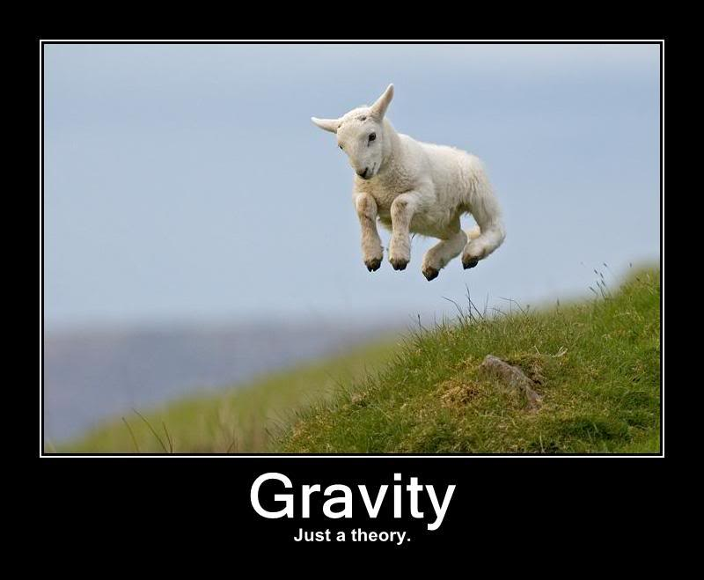

Slide 3
Gravity
The force that attracts objects with mass to one another.
The larger an objects mass the stronger its gravitational pull.

Slide 4
Gravity Continued
If gravity attracts objects to one another, and larger objects have a stronger gravitational pull, then why does the Earth not crash into the Sun?
https://www.youtube.com/watch?v=uhS8K4gFu4s

Slide 5
Our Size in the Universe
https://www.youtube.com/watch?v=HEheh1BH34Q

Slide 6
The Universe
Every expanding
Is there an end?
Contains all of space time, and everything that exists.

Slide 7
The Beginning
The Big Bang
Creation

Slide 8
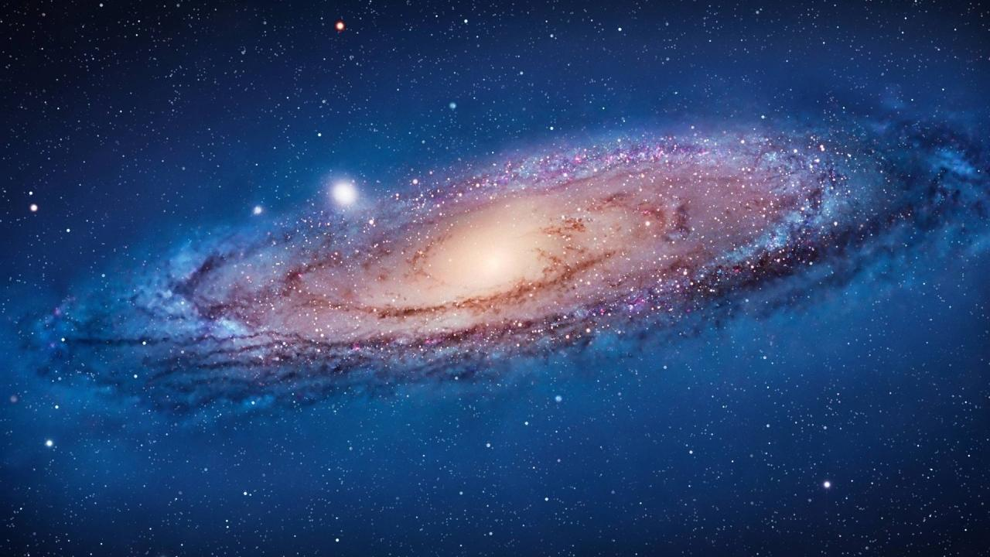
The Milky Way

Slide 9
The Milky Way
Has a spiral shape
Center is a supermassive black hole
Gravity
Contains hundred of billions of stars, and billions of planets.

Slide 10
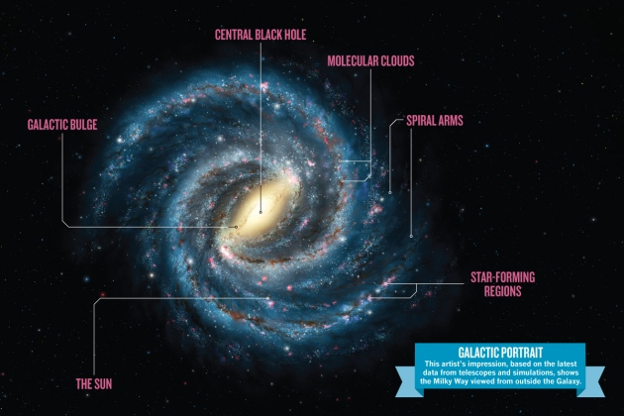
The Milky Way Map

Slide 11
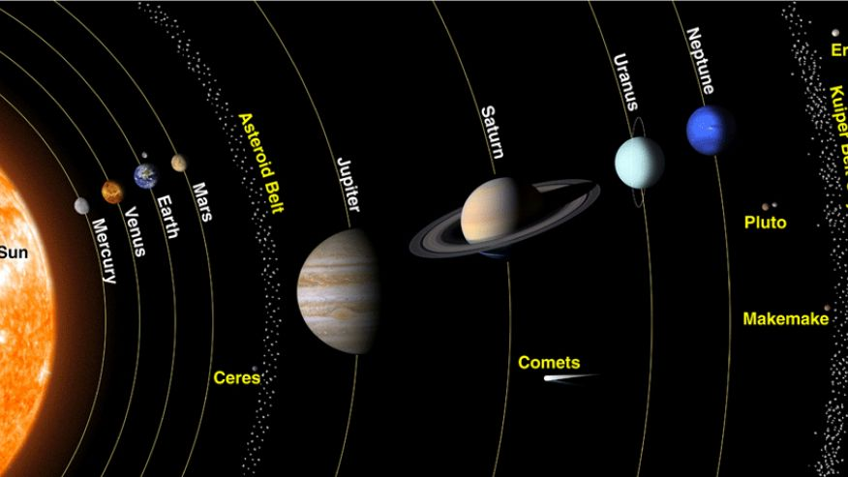
The Solar System

Slide 12
Our Solar System
The Sun + 8 planets
Mercury, Venus, Earth, Mars, Jupiter, Saturn, Uranus, Neptune
Part of the Milky Way Galaxy

Slide 13
Also Contains
Dwarf Planets
Comets
Meteoroids
Asteroids

Slide 14
Reflection
Describe gravity in one word. Why did you choose this word?

