Slide 1
Space Notes Pt. 2
To Infinity and Beyond!

Slide 2
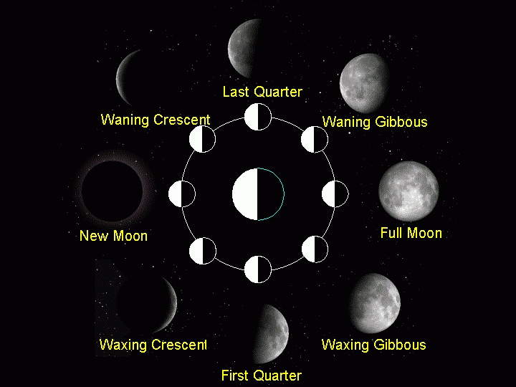
Moon Phases
The Sun lights up the moon
The phase depends on the positions of the Moon, Earth, and Sun.

Slide 3
Moon Phases 2

Slide 4
Why do we only see one side of the moon?
Answer : synchronous rotation

Slide 5
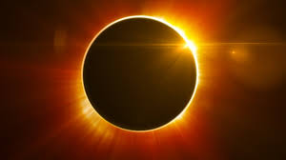
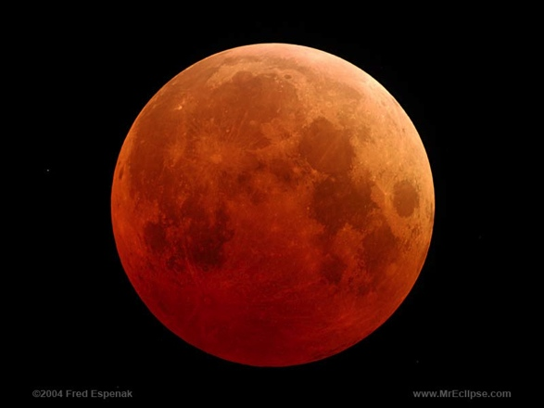
Eclipse
Two Kinds
Solar →→→
Lunar →→→→

Slide 6
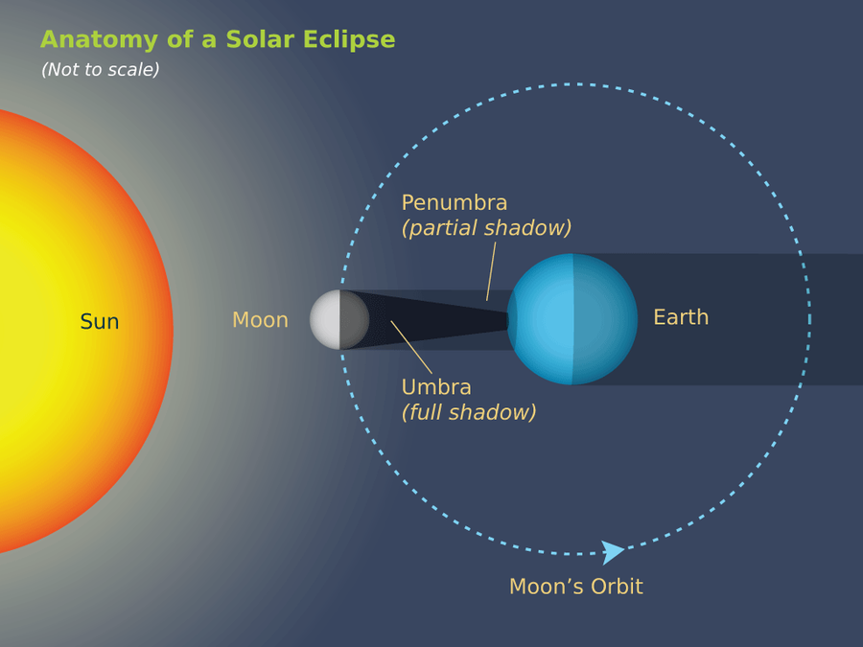
Solar Eclipse
Moon moves between the Sun and Earth.
2-3 a year
https://www.youtube.com/watch?v=eOvWioz4PoQ

Slide 7
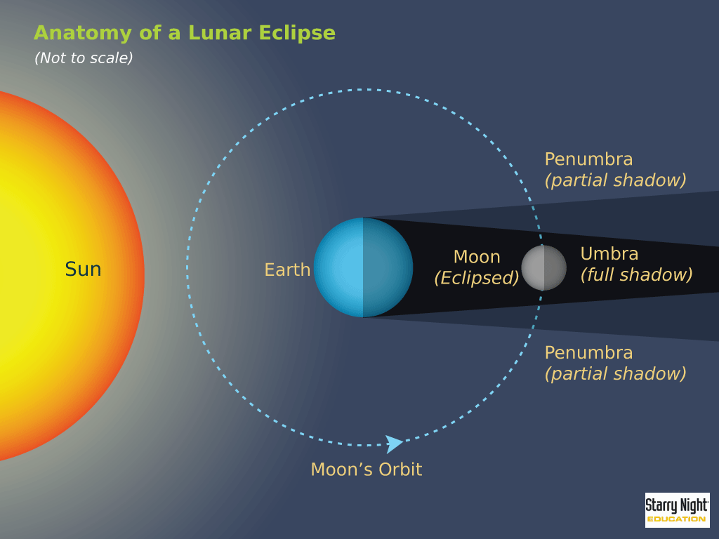
Lunar Eclipse
Earth moves between the Sun and Moon.
2-3 a year
https://www.youtube.com/watch?v=lcRp1jKJmJU

Slide 8
The Lives of Stars

Slide 9
Life of an Average Star
Nebulla → Average Sized Star → Red Giant → Nebulla → White Dwarf Star

Slide 10
The Lives of Stars

Slide 11
Life of a Massive Star
Nebulla → Massive Star → Red Supergiant → Supernova → Either neutron star or black hole

Slide 12
The Lives of Stars
https://www.youtube.com/watch?v=PM9CQDlQI0A

